Slide 1
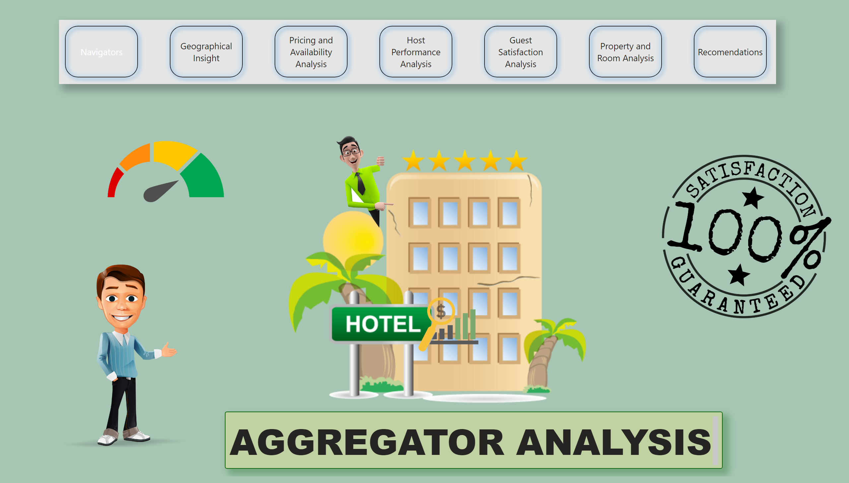

Navigators
Last data refresh:
5/15/2024 1:54:38 AM UTC
Downloaded at:
5/15/2024 1:59:51 AM UTC
View in Power BI
By: Ankeeta Chintawar
Notes:
image
No alt text provided
image
No alt text provided
image
No alt text provided
image
No alt text provided
image
No alt text provided
textbox
No alt text provided
pageNavigator
No alt text provided

Slide 2
Navigators
PROBLEM STATEMENT
Geographical Insights: -
Visualize the distribution of listings on a map to identify popular neighborhoods.
Explore the geographical concentration of listings and host location
Pricing and Availability Analysis:-
Analyze pricing trends based on property types, room types, and accommodation capacity.
Investigate the availability of listings over time and identify peak periods.
Host Performance:-
Evaluate host characteristics, including superhost status, response times, and verification methods.
Explore correlations between host attributes and listing performance.
Review Scores and Guest Satisfaction:-
Examine review scores and their impact on overall listing performance.
Identify areas for improvement based on specific review categories.
Property Type and Room Analysis:-
Analyze the distribution of property types and room types.
Explore trends in the popularity of specific accommodation setups.
Deliverables
Interactive Power BI dashboards illustrating geographical distribution, pricing trends, host characteristics, and review scores.
Reports on availability patterns, property and room preferences, and factors influencing guest satisfaction.
Recommendations for hosts and the aggregator platform based on the analysis.
Notes:
image
No alt text provided
image
No alt text provided
image
No alt text provided
image
No alt text provided
image
No alt text provided
textbox
No alt text provided
pageNavigator
No alt text provided

Slide 3
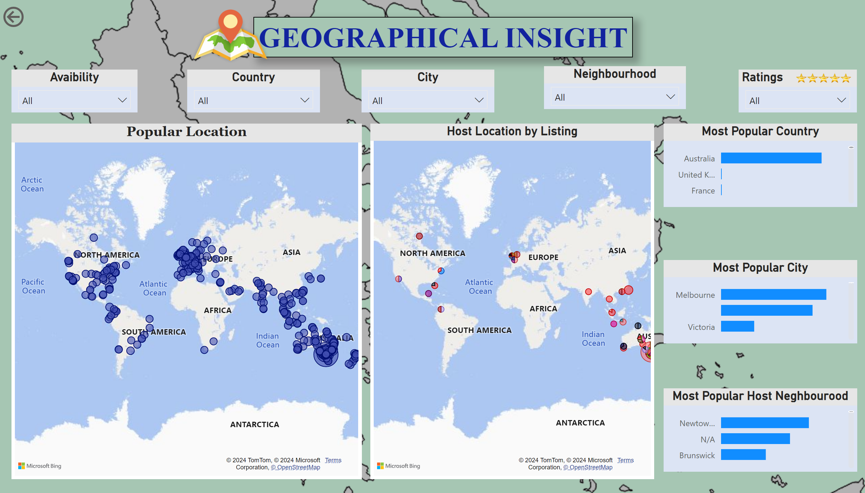
Geographical Insight
Notes:
Popular Location
No alt text provided
Avaibility
No alt text provided
Country
No alt text provided
City
No alt text provided
textbox
No alt text provided
Host Location by Listing
No alt text provided
Most Popular Country
No alt text provided
Most Popular Host Neghbourood
No alt text provided
Most Popular City
No alt text provided
image
No alt text provided
Ratings
No alt text provided
image
No alt text provided
Neighbourhood
No alt text provided
actionButton
No alt text provided

Slide 4
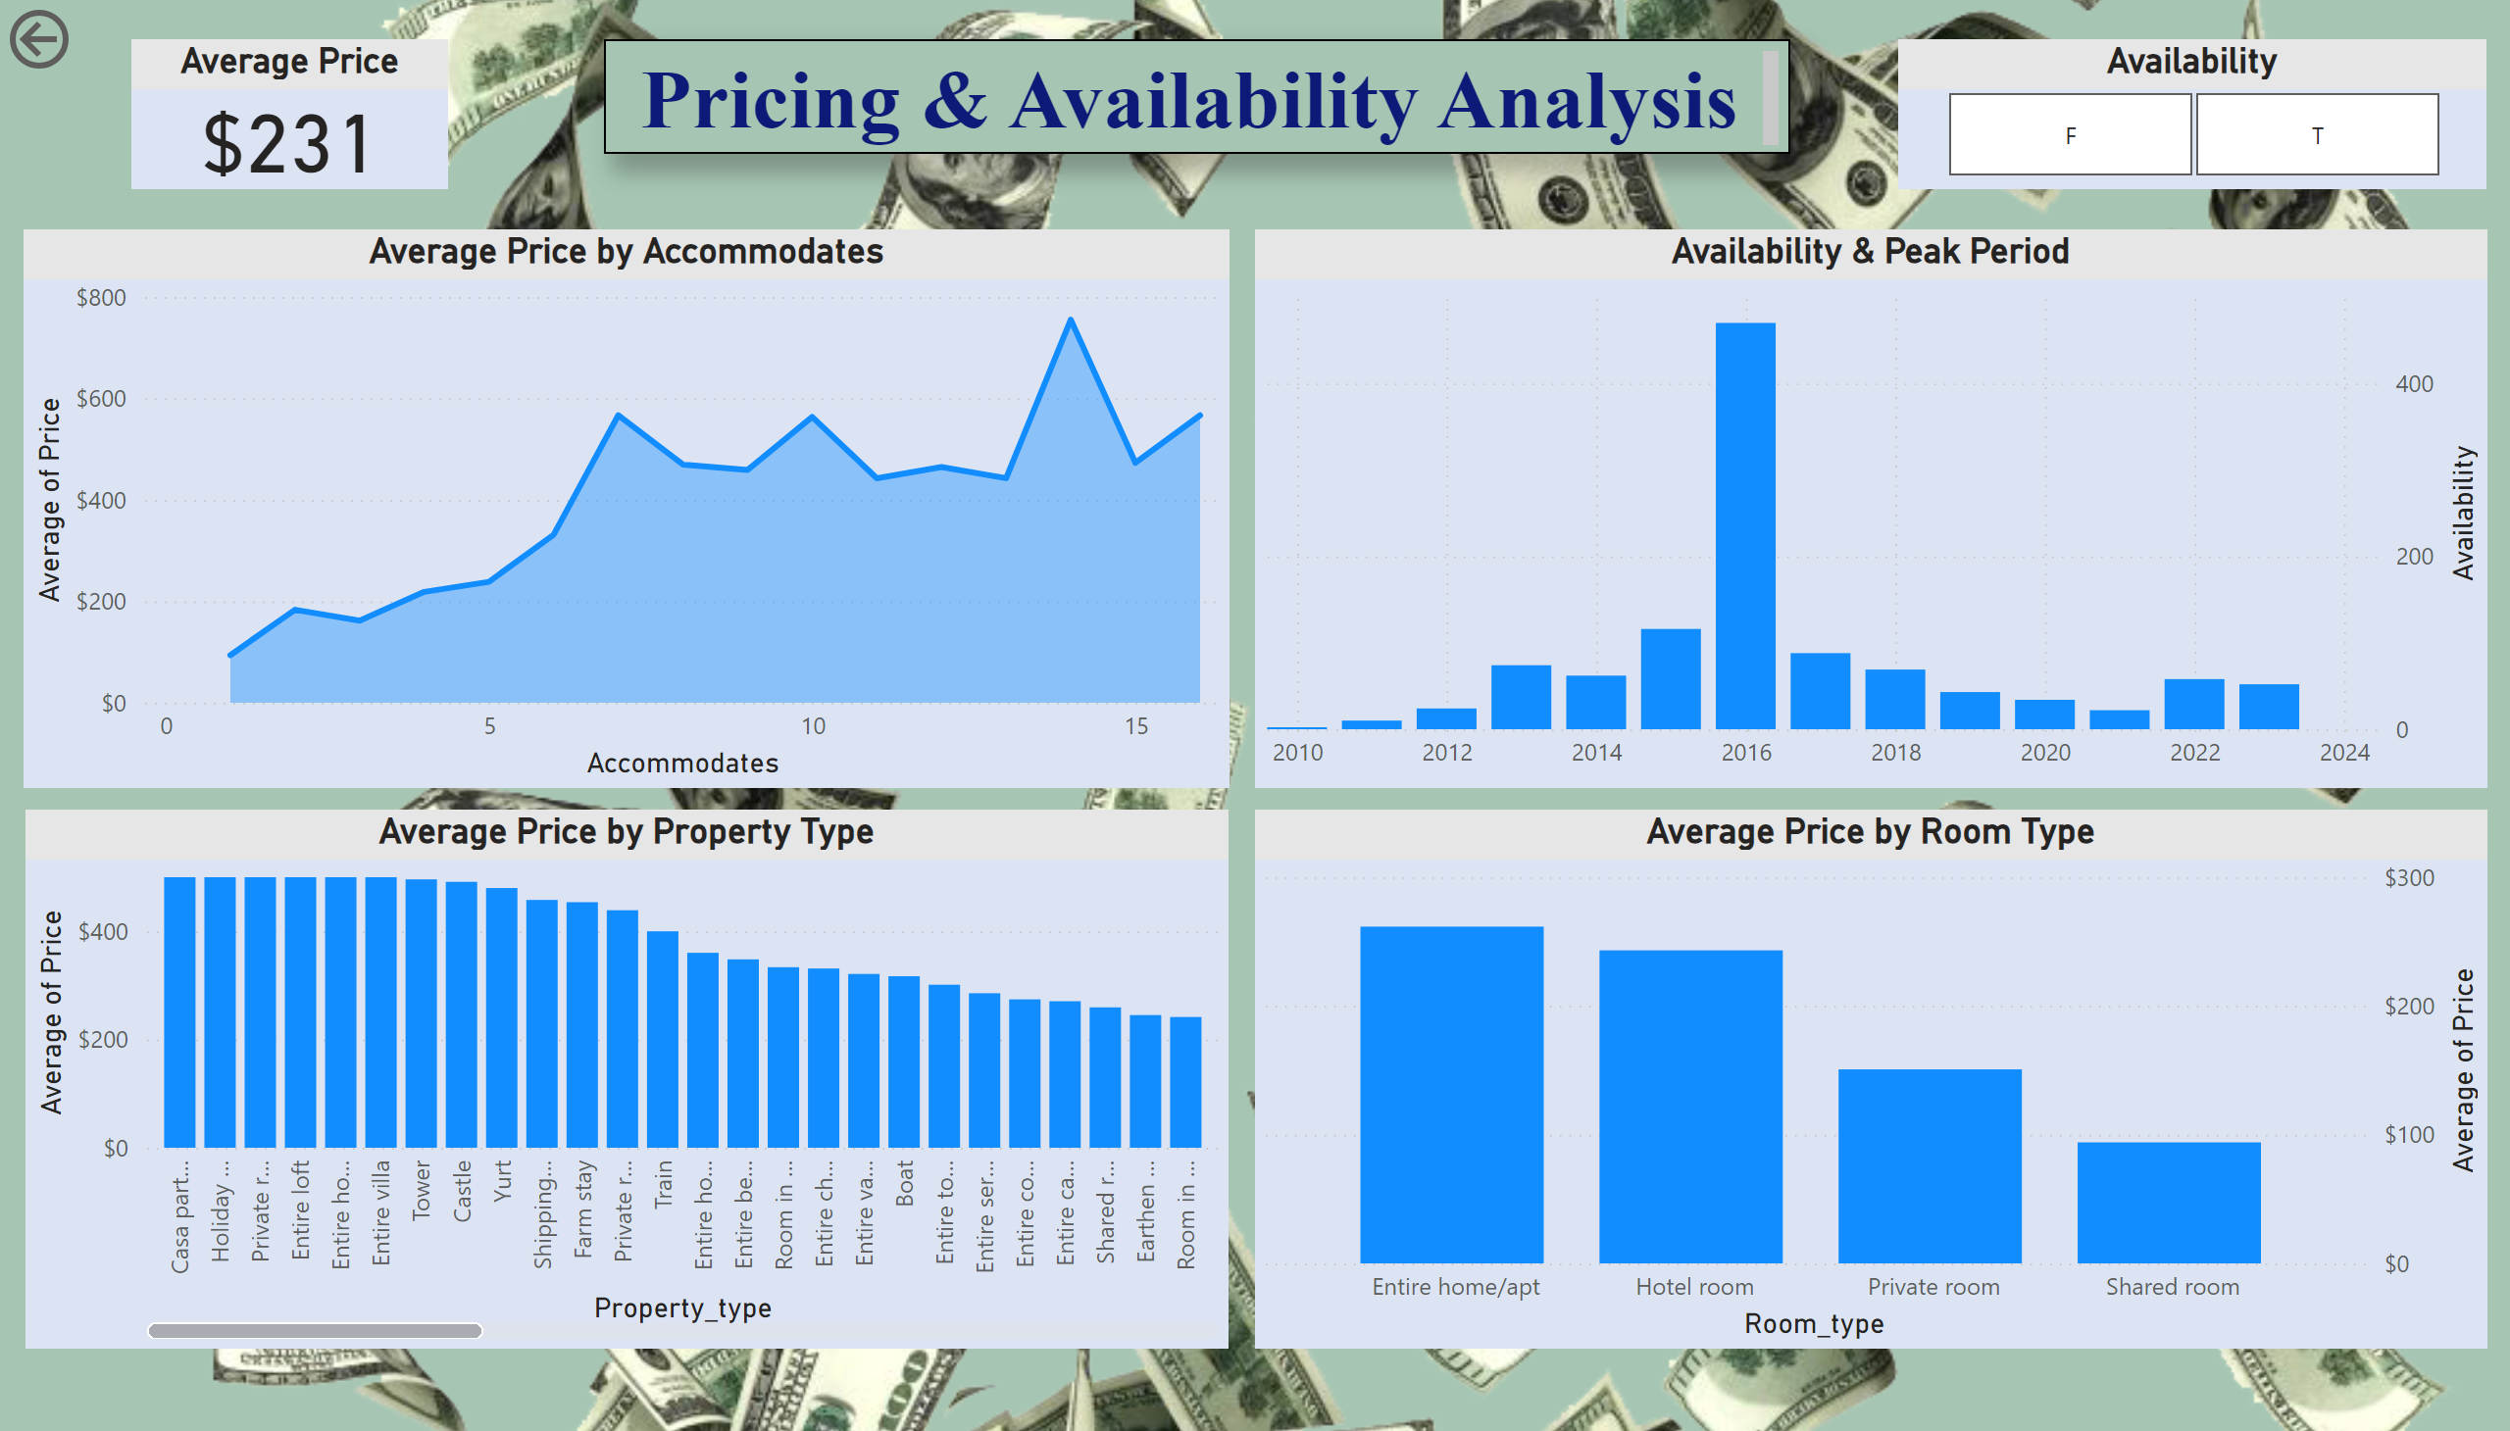
Pricing and Availability Analysis
August 2016
Notes:
Average Price by Accommodates
No alt text provided
Average Price by Property Type
No alt text provided
Average Price by Room Type
No alt text provided
Availability & Peak Period
No alt text provided
actionButton
No alt text provided
Average Price
No alt text provided
textbox
No alt text provided
Availability
No alt text provided

Slide 5
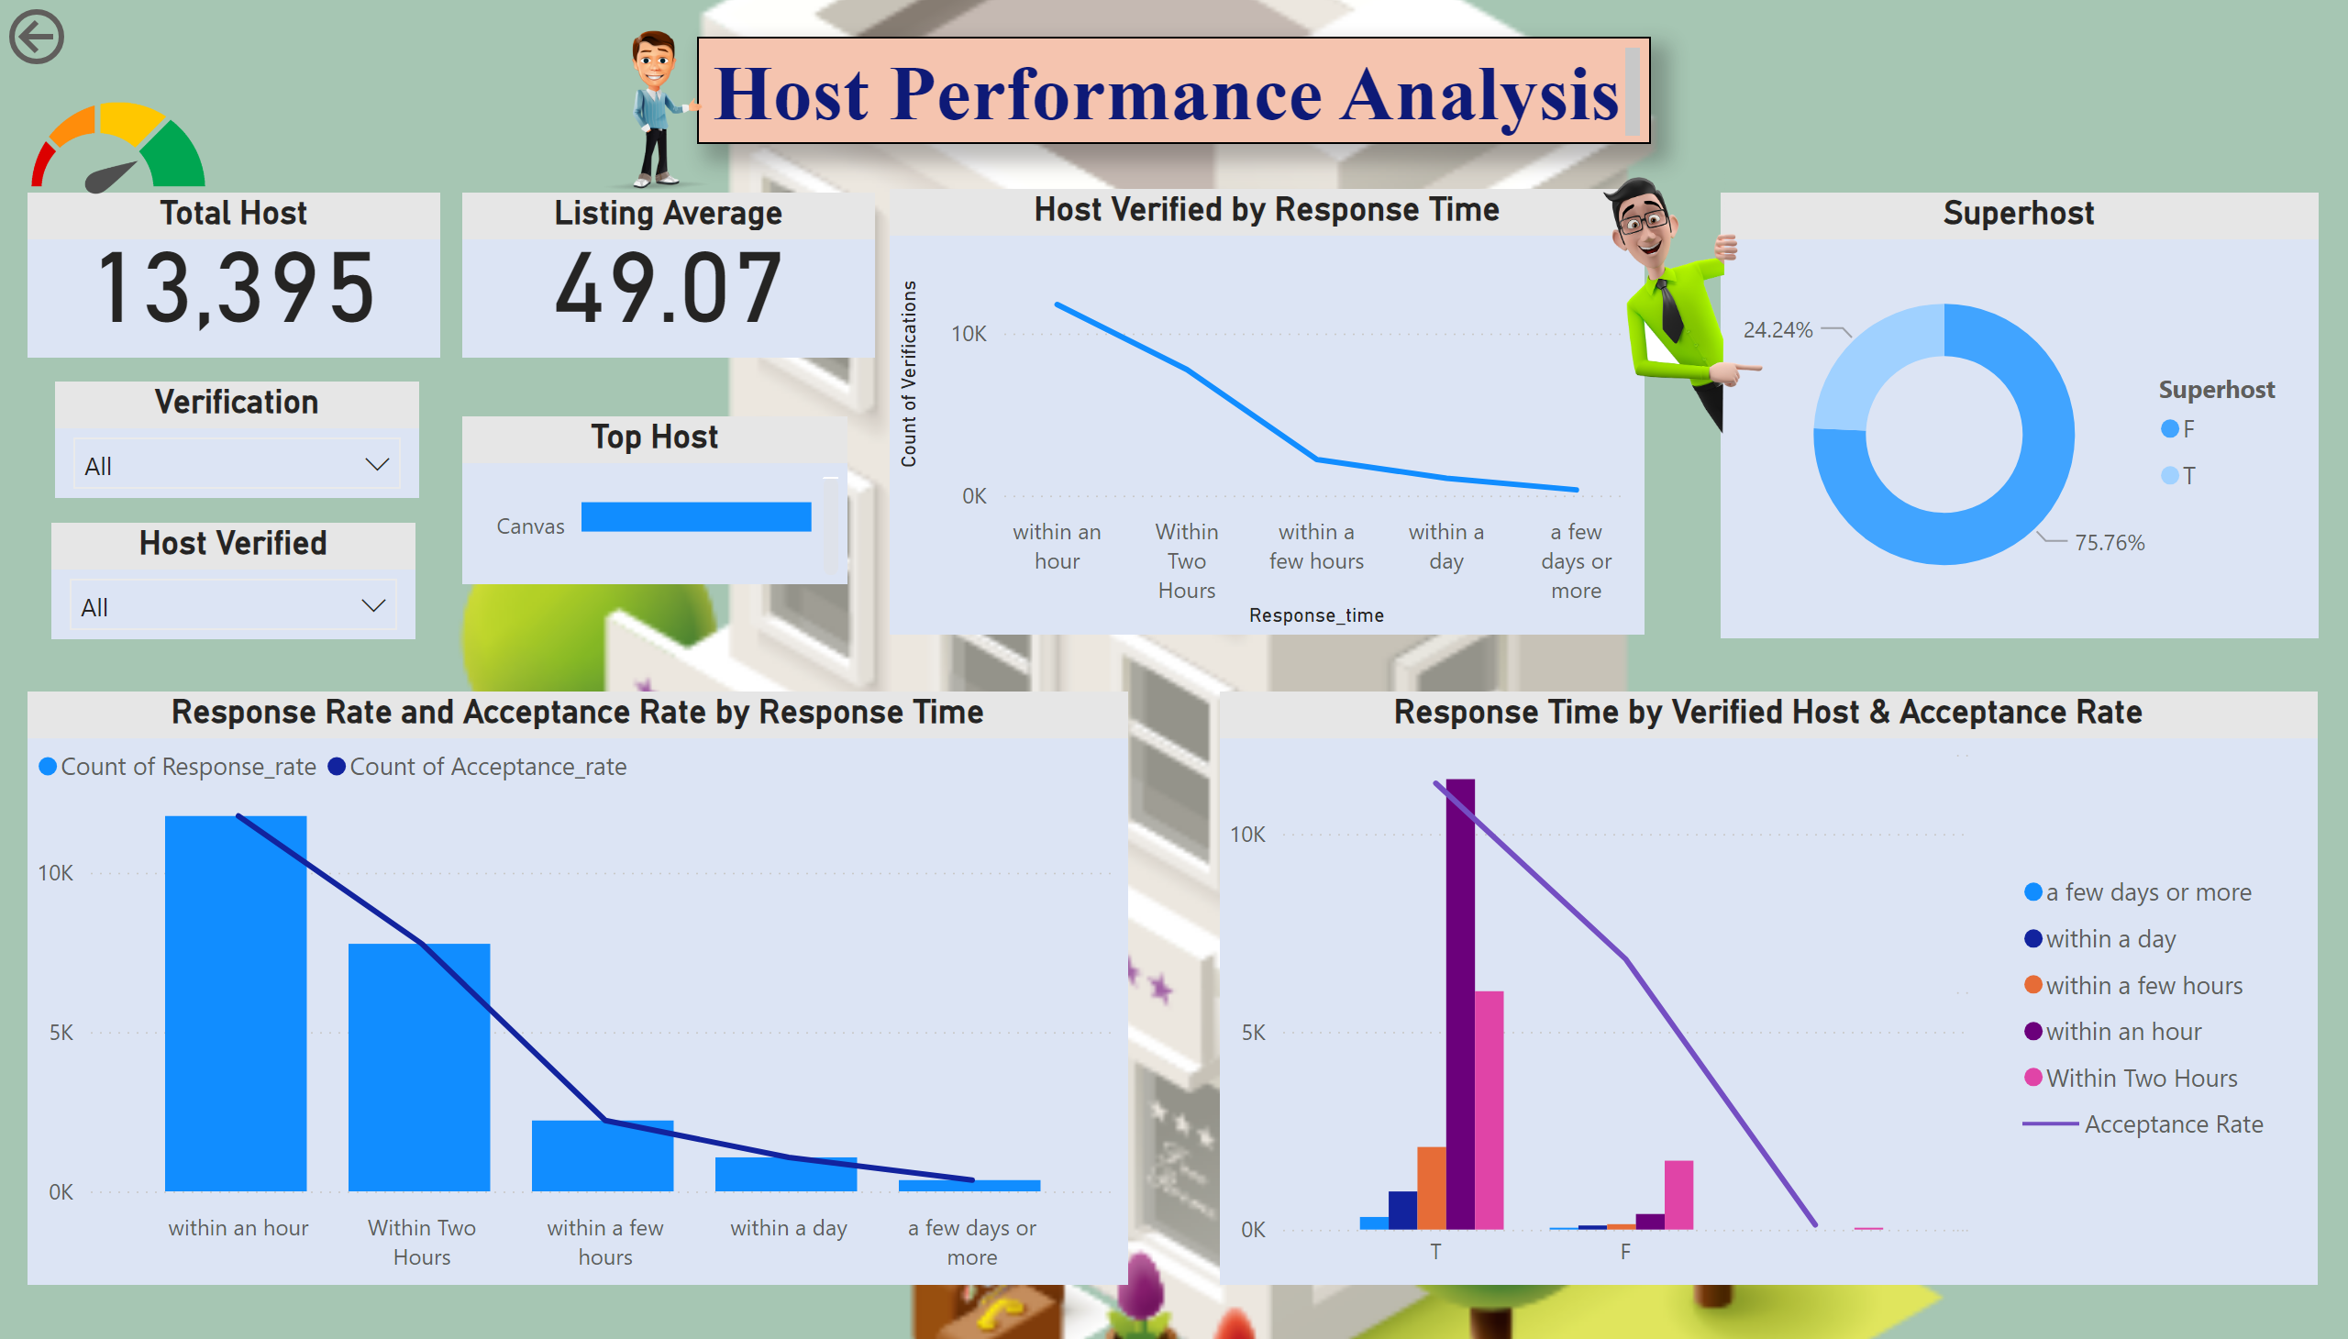
Host Performance Analysis
Notes:
textbox
No alt text provided
Host Verified
No alt text provided
Total Host
No alt text provided
Superhost
No alt text provided
Response Rate and Acceptance Rate by Response Time
No alt text provided
Response Time by Verified Host & Acceptance Rate
No alt text provided
Host Verified by Response Time
No alt text provided
Top Host
No alt text provided
Verification
No alt text provided
Listing Average
No alt text provided
image
No alt text provided
image
No alt text provided
image
No alt text provided
actionButton
No alt text provided

Slide 6
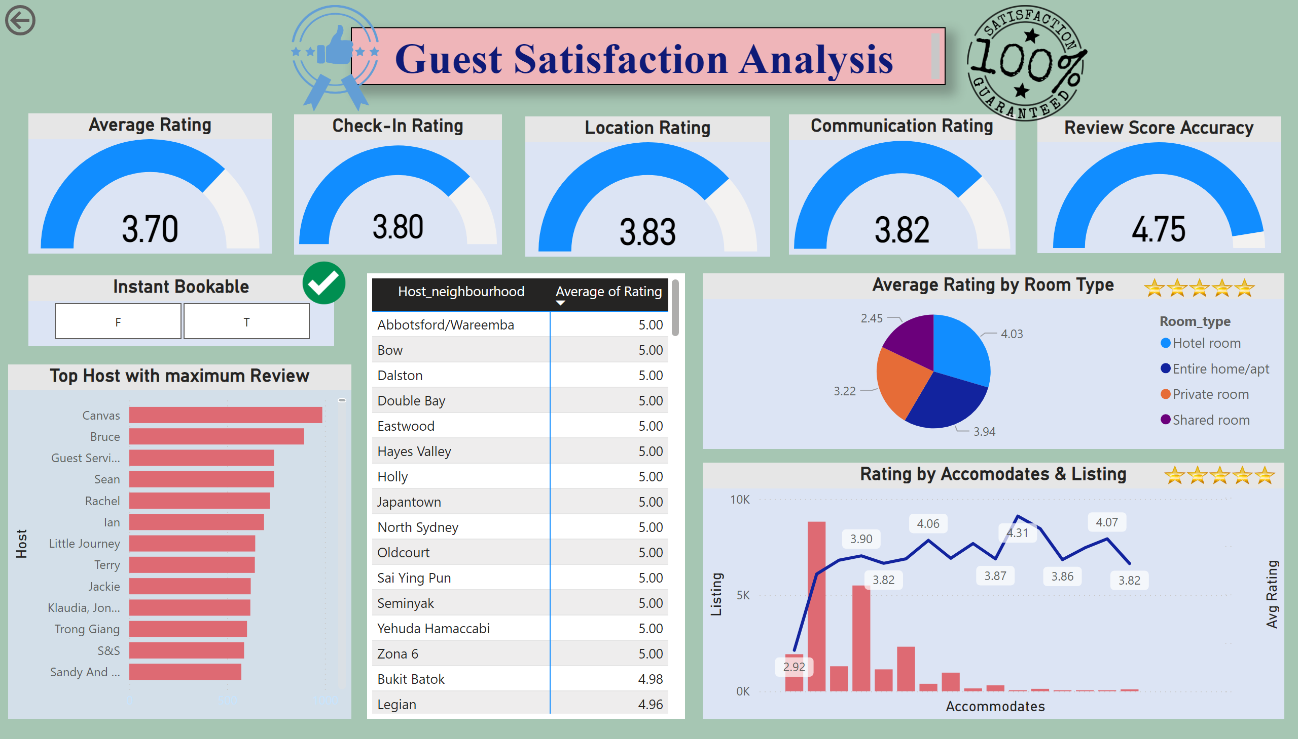
Guest Satisfaction Analysis
Notes:
textbox
No alt text provided
Check-In Rating
No alt text provided
Communication Rating
No alt text provided
Location Rating
No alt text provided
Average Rating by Room Type
No alt text provided
Rating by Accomodates & Listing
No alt text provided
pivotTable
No alt text provided
Average Rating
No alt text provided
Instant Bookable
No alt text provided
Review Score Accuracy
No alt text provided
Top Host with maximum Review
No alt text provided
image
No alt text provided
image
No alt text provided
image
No alt text provided
image
No alt text provided
image
No alt text provided
actionButton
No alt text provided

Slide 7
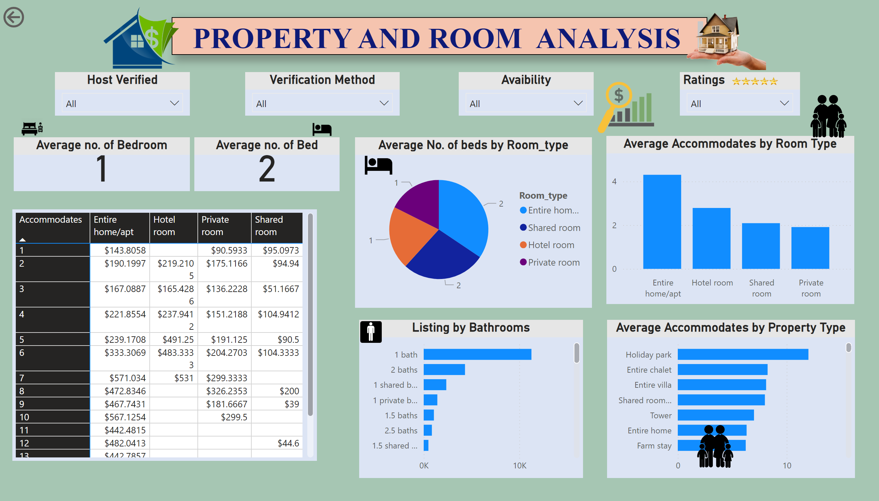
Property and Room Analysis
Notes:
pivotTable
No alt text provided
Host Verified
No alt text provided
Verification Method
No alt text provided
Avaibility
No alt text provided
Ratings
No alt text provided
image
No alt text provided
image
No alt text provided
Average no. of Bed
No alt text provided
image
No alt text provided
Average Accommodates by Room Type
No alt text provided
image
No alt text provided
Average Accommodates by Property Type
No alt text provided
image
No alt text provided
Average No. of beds by Room_type
No alt text provided
image
No alt text provided
textbox
No alt text provided
image
No alt text provided
Listing by Bathrooms
No alt text provided
image
No alt text provided
image
No alt text provided
Average no. of Bedroom
No alt text provided
image
No alt text provided
actionButton
No alt text provided

Slide 8
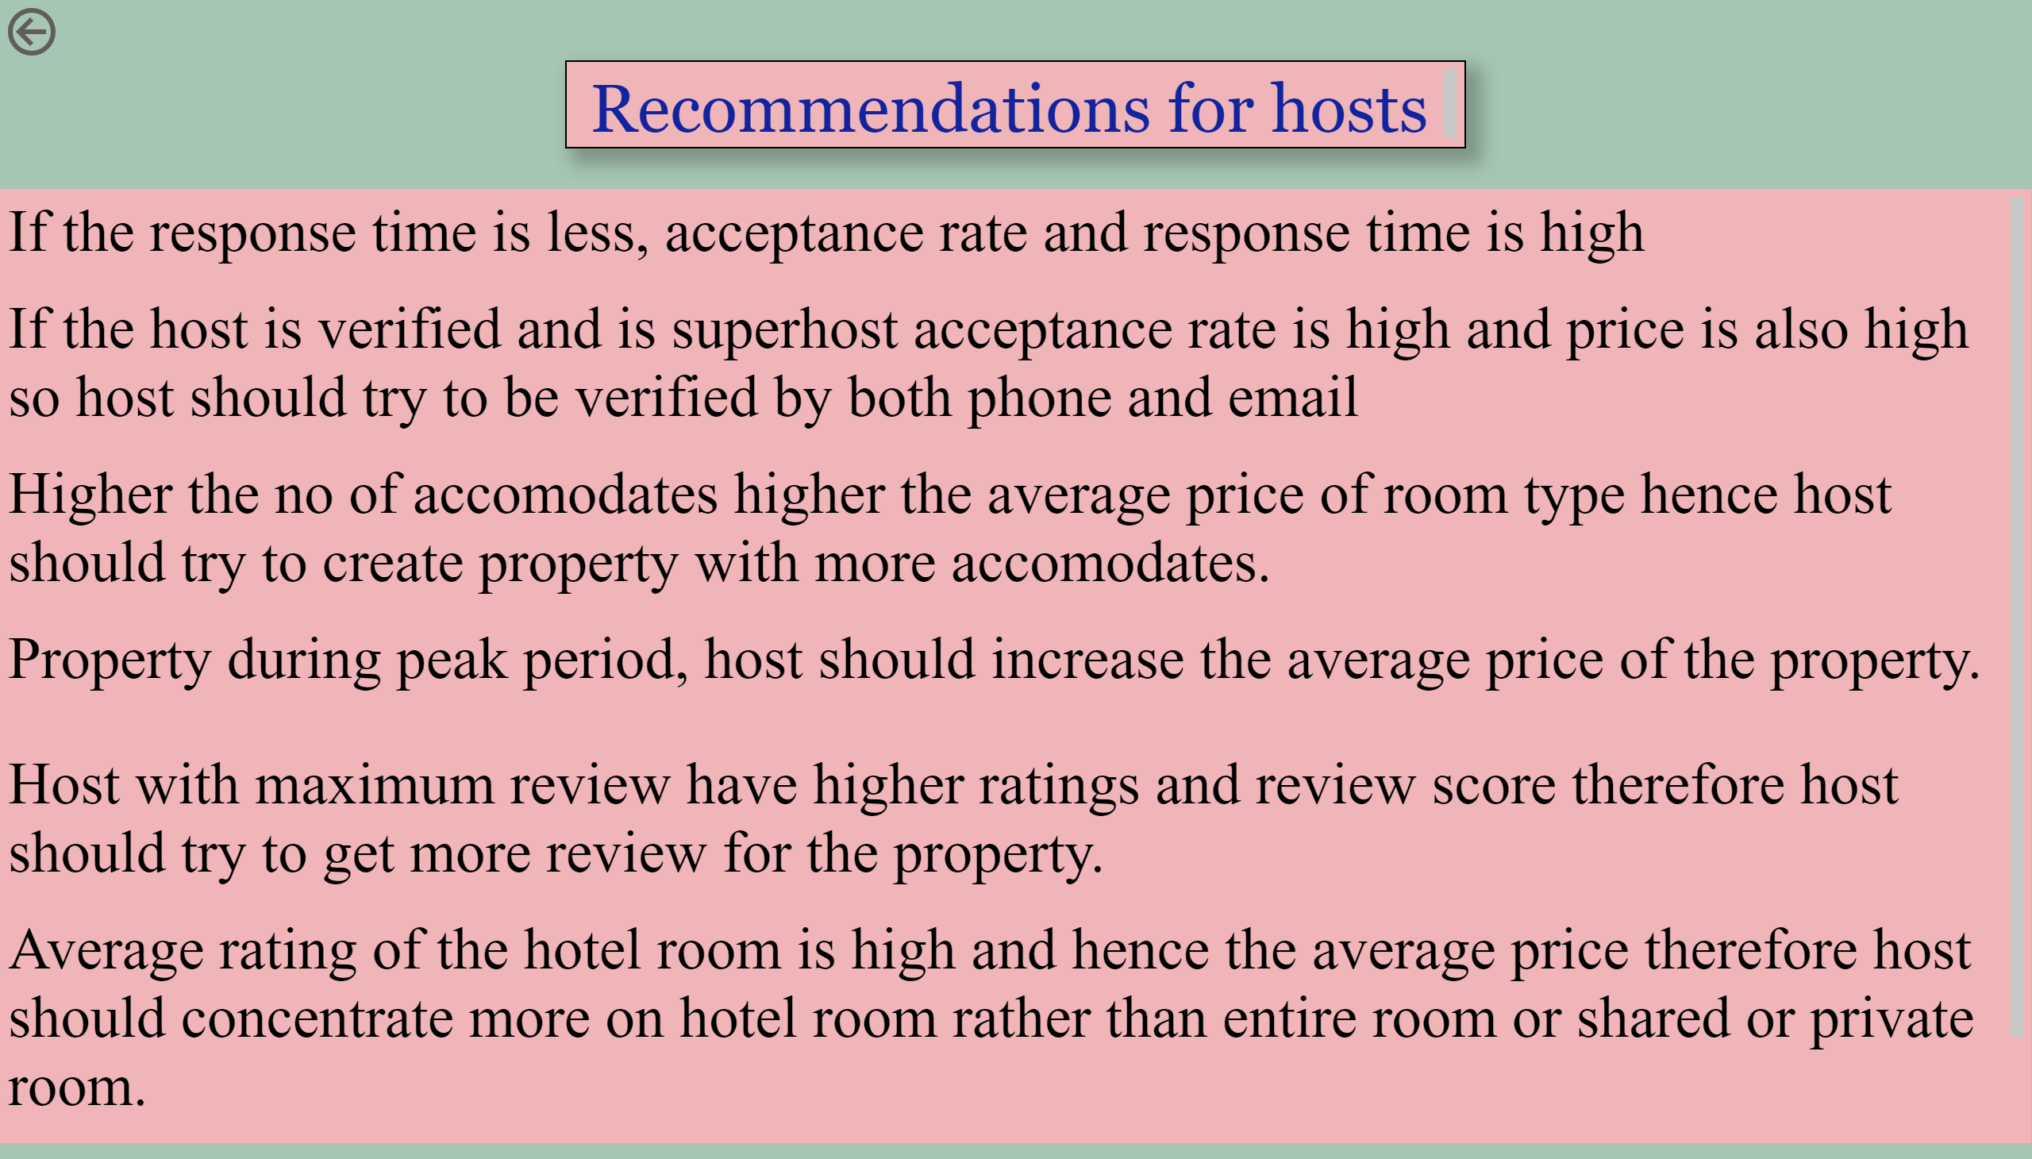
Recomendations
If the response time is less, acceptance rate is high, hence host should response early.
Notes:
textbox
No alt text provided
textbox
No alt text provided
actionButton
No alt text provided

Slide 9




Recomendations
THANK YOU!
Notes:
textbox
No alt text provided
textbox
No alt text provided
actionButton
No alt text provided

